Slide 1
PROJECT III · REPORT 1
FROM BASELINE TO INTELLIGENT SUPPORT
PROJECT III / TOOLS FOR PROGRAM DEVELOPMENT
Report 1 —
Project Proposal
Ticket input
Smart triage
Text + attachments
ML.NET + priority
Intelligent IT Helpdesk Platform with Automated Classification & Incident Routing
Knowledge
Agent routing
TF-IDF matching
Workload + SLA
Student
Șerban Alexandru-Cristian-George
Computer Engineering (English) · 4th Year
LIVE COLLABORATION
SignalR chat + instant notifications
A functional helpdesk baseline, extended with intelligent triage, recommendations, balancing, and live updates.
TRACEABILITY • REPRODUCIBILITY • AUTOMATION
REPORT 1 · PROJECT PROPOSAL / 2026
Notes:
Introduce the project as an extension of an existing ASP.NET Core MVC helpdesk, not a greenfield rebuild. The proposal focuses on automating triage, surfacing relevant knowledge, balancing agent workload, and improving real-time collaboration.

Slide 2
01 / MOTIVATION
Why make the helpdesk intelligent?
The existing platform supports core ticketing; Project III targets the expensive manual steps around triage and resolution.
CURRENT PAIN POINTS
PROJECT OBJECTIVE
Users often select the wrong category, department, or priority.
Turn the existing role-based web app into an intelligent support workflow.
Agents spend time re-routing tickets and diagnosing recurring issues.
01
Classify
Suggest category, department, and priority
Ticket comments require manual refresh to see new replies.
02
Recommend
Surface relevant articles and similar cases
03
Route
Balance workload and monitor SLA
Unassigned tickets and approaching SLA deadlines can go unnoticed.
04
Connect
Live chat and instant status alerts
EXPECTED DIRECTION
Less manual triage
Faster reuse of knowledge
More balanced queues
Live communication
PROJECT III / TOOLS FOR PROGRAM DEVELOPMENT
02
Notes:
Describe the operational problems in the current helpdesk. Emphasize that the objective is to reduce avoidable routing work and shorten the path from incident description to useful action, while extending rather than replacing the baseline application.

Slide 3
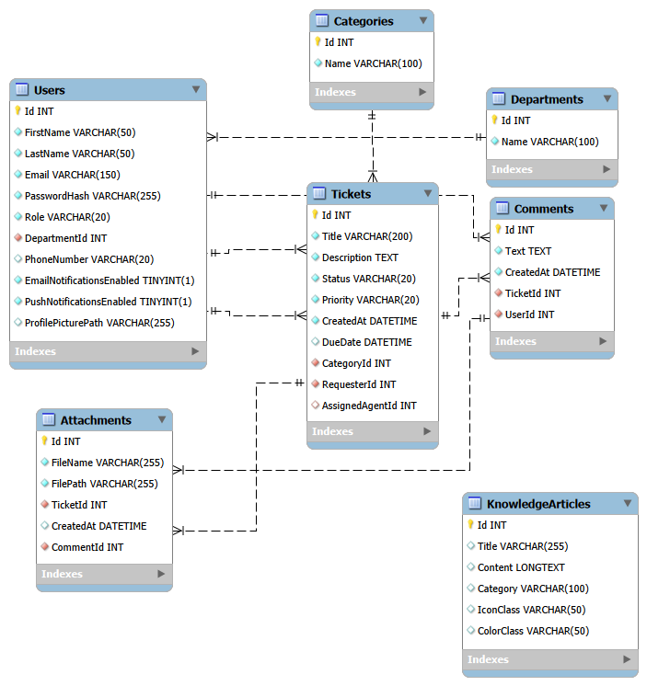
02 / EXISTING SYSTEM
Current state: a working N-tier baseline
The proposal extends the WAD Milestone 4 application built with ASP.NET Core MVC and Entity Framework Core.
EXISTING ARCHITECTURAL LAYERS
Presentation layer
MVC controllers, Razor views, role-specific layouts
Business logic / services
AuthService, TicketService, UserService, and other DI services
Data access layer
EF Core, HelpdeskContext, repositories, Unit of Work
Persistent storage
Relational data and seeded baseline records
Design principle: keep new modules inside the existing Service Layer and Dependency Injection pattern.
PROJECT III / TOOLS FOR PROGRAM DEVELOPMENT
03
Notes:
The important point is that the application already has distinct presentation, service, and data-access layers, so new capabilities should follow the same separation and dependency-injection approach.

Slide 4
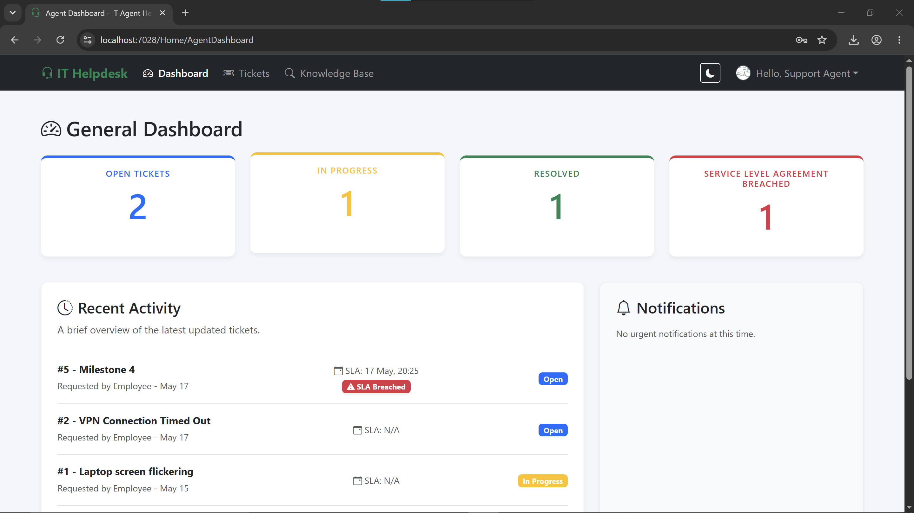
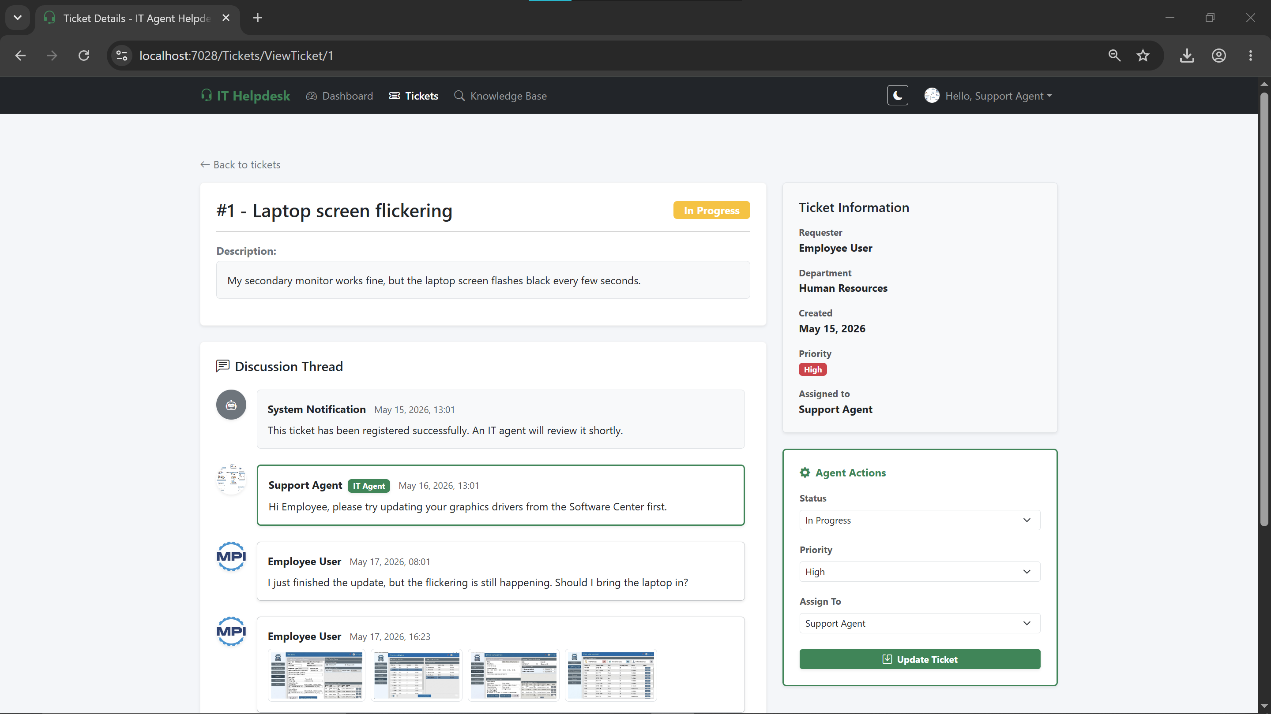
03 / BASELINE CAPABILITIES
Existing platform: what already works
The project builds on role-based dashboards, ticket submission and tracking, comments, attachments, and a managed Knowledge Base.
Role-based access
Ticket lifecycle
Knowledge Base
Administration
Administrator · Support Agent · User · Guest
Submit, attach files, track status, and comment
Create, search, and browse help articles
Manage users, departments, and categories
PROJECT III / TOOLS FOR PROGRAM DEVELOPMENT
04
Notes:
These two screenshots communicate which parts already exist and where the proposed smart features will be integrated.

Slide 5
04 / PROJECT SCOPE
Four enhancements planned for Project III
The scope evolves the existing ticket flow with automated classification, semantic recommendations, workload balancing, and real-time communication.
3.1
Automated classification
3.2
Semantic recommendations
ML.NET
TF-IDF + COSINE SIMILARITY
Predict Category, Department, and Priority from ticket title and description. Integrate with SubmitTicket.cshtml.
Recommend the top 3 Knowledge Base articles to users and similar resolved tickets to agents.
OUTPUT · structured ticket metadata
OUTPUT · relevant guidance
3.3
Workload balancing + SLA
3.4
Real-time communication
TICKETSERVICE + IHOSTEDSERVICE
ASP.NET CORE SIGNALR
Assign tickets to the available agent with the lowest weighted workload; scan deadlines and escalate when needed.
Turn static comments into live user-agent conversation and show instant assignment, update, and escalation alerts.
OUTPUT · balanced queues
OUTPUT · immediate updates
PROJECT III / TOOLS FOR PROGRAM DEVELOPMENT
05
Notes:
Introduce the four development modules as the scope for the upcoming Report 2 prototype and final implementation. Keep the distinction clear: these are planned extensions, not claims that the intelligent modules already exist.

Slide 6
05 / PLANNED MODULE 1
Automated ticket classification & prioritization
ML.NET will assist users by predicting key ticket fields from the issue text at submission time.
TARGET: UNDER 100 MS PER REQUEST
01
02
03
04
Ticket text
TicketPredictionService
ML.NET model
Predicted fields
Title + description
Called from ticket submission
SdcaMaximumEntropy
Category · Department · Priority
IMPLEMENTATION NOTES
EXPECTED BENEFIT
Train on historical ticket titles and descriptions.
More consistent triage
Let the user leave category / priority blank for automatic prediction.
Predictions are a starting point for support workflow; the system still needs validation against representative historical data.
PROJECT III / TOOLS FOR PROGRAM DEVELOPMENT
06
Notes:
Explain the path from text input to a prediction service and then the ML.NET multiclass classifier. The proposal names SdcaMaximumEntropy and sets a performance target below 100 milliseconds per request; these targets will need to be measured in implementation.

Slide 7
06 / PLANNED MODULE 2
Semantic recommendations: find known answers faster
TF-IDF vectors and cosine similarity will connect a new issue to existing knowledge and resolved tickets.
SELF-SERVICE + AGENT ASSISTANCE
Description
TF-IDF
Cosine similarity
Top 3 relevant articles
User types issue
Text → weighted vector
Rank semantic matches
Show links while user types
USER SELF-SERVICE
AGENT RESOLUTION ASSISTANT
SubmitTicket.cshtml
ViewTicket.cshtml
As the description changes, call the service asynchronously via AJAX.
Compare the open issue with historical resolved tickets.
Display the three best-matching Knowledge Base articles before ticket creation.
Offer similar cases as diagnostic hints; agents retain decision authority.
Similarity quality depends on text preprocessing and the content of existing articles / tickets.
PROJECT III / TOOLS FOR PROGRAM DEVELOPMENT
07
Notes:
Describe the two usage points separately. Users receive article suggestions as they type through an asynchronous call; agents receive similar resolved ticket suggestions in the ticket detail view. The approach is a custom TF-IDF and cosine similarity engine rather than a separate hosted AI dependency.

Slide 8
07 / PLANNED MODULE 3
Smart agent workload balancing & SLA monitoring
Automated assignment reduces idle queues; a background worker helps catch response deadlines before they are missed.
WEIGHTED LEAST-LOADED ASSIGNMENT
SLA BACKGROUND WORKER
New ticket
TicketService
01
Scan open tickets
Department + priority weighting
Periodic IHostedService execution
Illustrative active workload scores
02
Check SLA deadlines
Agent 1
78
Compare elapsed time with target response window
Agent 2
42
03
Escalate when needed
Agent 3
26
Raise priority as the deadline approaches or is breached
Assign to Agent 3
Lowest current workload score
Target: proactive escalation + clearer ownership
PROJECT III / TOOLS FOR PROGRAM DEVELOPMENT
08
Notes:
Explain that assignment is weighted by current active tickets and their priorities, not just round-robin rotation. The SLA worker is planned as an IHostedService and periodically scans open tickets to escalate priority as deadlines approach or are breached. The workload values on the slide are illustrative only.

Slide 9
08 / PLANNED MODULE 4
Real-time communication with SignalR
Replace the current refresh-to-see-comments experience with a live conversation and immediate assignment / update notifications.
USER
client → hub
HUB
hub → agent
AGENT
Client browser
TicketHub
Support agent
ViewTicket.cshtml
Send / receive comments
hub → client
ASP.NET Core SignalR
Two-way event delivery
agent → hub
Live ticket conversation
Immediate ticket updates
REAL-TIME EVENTS
Ticket assigned
New comment
Status updated
SLA escalated
Performance target from the proposal: SignalR notifications under 50 ms on the local network.
Implementation touchpoints: TicketHub · _AgentLayout.cshtml · _UserLayout.cshtml
PROJECT III / TOOLS FOR PROGRAM DEVELOPMENT
09
Notes:
Contrast the current need to refresh a page with the proposed SignalR hub. Comments can be delivered in real time, while layout-level toast notifications inform users and agents about assignment, update, or escalation events. The under-50-ms value is a target stated in the project specification, not a measured result.

Slide 10
09 / SYSTEM SPECIFICATIONS
Actors, functional requirements & quality targets
The new modules fit into the existing role-based access model and must preserve maintainability and traceability.
G
Guest
U
User / Client
EXISTING
Browse public Knowledge Base • Authenticate
EXISTING
Submit tickets + attachments • Track tickets and comment
PLANNED
No new privileged actions
PLANNED
Get article suggestions • Use live chat / instant alerts
SA
Support Agent
A
Administrator
EXISTING
View queues and statistics • Publish troubleshooting articles
EXISTING
Manage users, roles, teams • Manage departments/categories
PLANNED
See similar resolved tickets • Receive balanced assignments
PLANNED
Monitor SLA breach metrics • Trigger model retraining
NON-FUNCTIONAL TARGETS
ML / TF-IDF < 100 ms
SignalR < 50 ms on LAN
Service-layer modularity
GitHub traceability
PROJECT III / TOOLS FOR PROGRAM DEVELOPMENT
10
Notes:
Walk through the four roles and distinguish current abilities from planned additions. Call out that the latency values are specification targets, while modularity and traceability are cross-cutting quality requirements for every new module.

Slide 11
10 / DEVELOPMENT TOOLCHAIN
Technology stack: existing foundations + planned modules
New capabilities are designed to fit the project’s current C# / ASP.NET Core architecture.
IDE & DEBUGGING
WEB FRAMEWORK
TICKET ML
RECOMMENDATION ENGINE
Visual Studio 2022 / VS Code
ASP.NET Core MVC + EF Core
ML.NET
TF-IDF + cosine similarity
C# compilation, Razor editing, debugger, CPU / memory diagnostics
Controllers, views, dependency injection, LINQ, ORM
Multiclass text classification with SdcaMaximumEntropy
Custom C# text vectors and ranked recommendations
LIVE EVENTS & JOBS
FRONTEND
DATABASE & MODELING
TRACEABILITY & TESTING
SignalR + IHostedService
Bootstrap 5 · Razor · jQuery
SQL Server / SQLite · MySQL Workbench
Git · GitHub · Draw.io · Postman
Two-way chat, toast alerts, and SLA deadline scanning
Responsive layouts, validation, and LibMan client libraries
Relational storage and EER/schema modeling
Issues, milestones, commits, use-case modeling, API checks
Baseline rule: new modules should use the existing Service Layer + Dependency Injection pattern.
PROJECT III / TOOLS FOR PROGRAM DEVELOPMENT
11
Notes:
Summarize the selected tools directly from the proposal. Visual Studio or VS Code will be used for the C# solution; ML.NET and a custom TF-IDF service add intelligence; SignalR and IHostedService handle events and background monitoring; GitHub provides traceability.

Slide 12
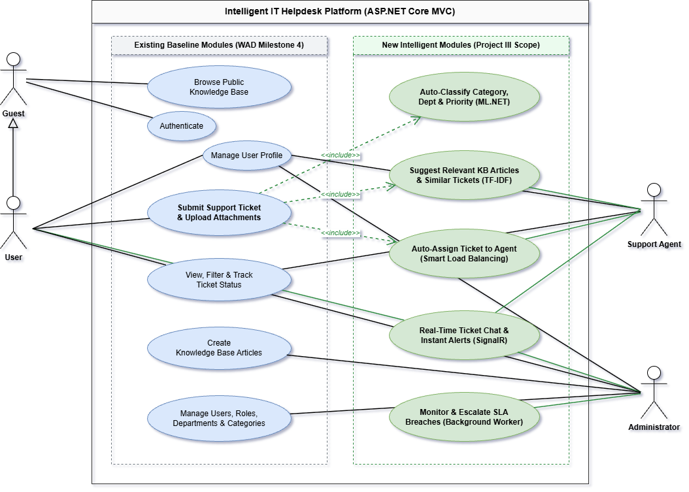
11 / SYSTEM MODELING
Use Case Diagram: current baseline vs. new modules
The diagram distinguishes existing WAD functionality from planned Project III capabilities.
LEGEND
Existing baseline
WAD Milestone 4
New Project III
Planned intelligent modules
Actors
Guest
User / Client
Support Agent
Administrator
Ticket submission automatically triggers ML classification, TF-IDF matching, and smart routing via <<include>> relationships.
PROJECT III / TOOLS FOR PROGRAM DEVELOPMENT
12
Notes:
The key visual distinction is between blue existing baseline use cases and green new Project III modules, with four actors: Guest, User, Support Agent, and Administrator.

Slide 13
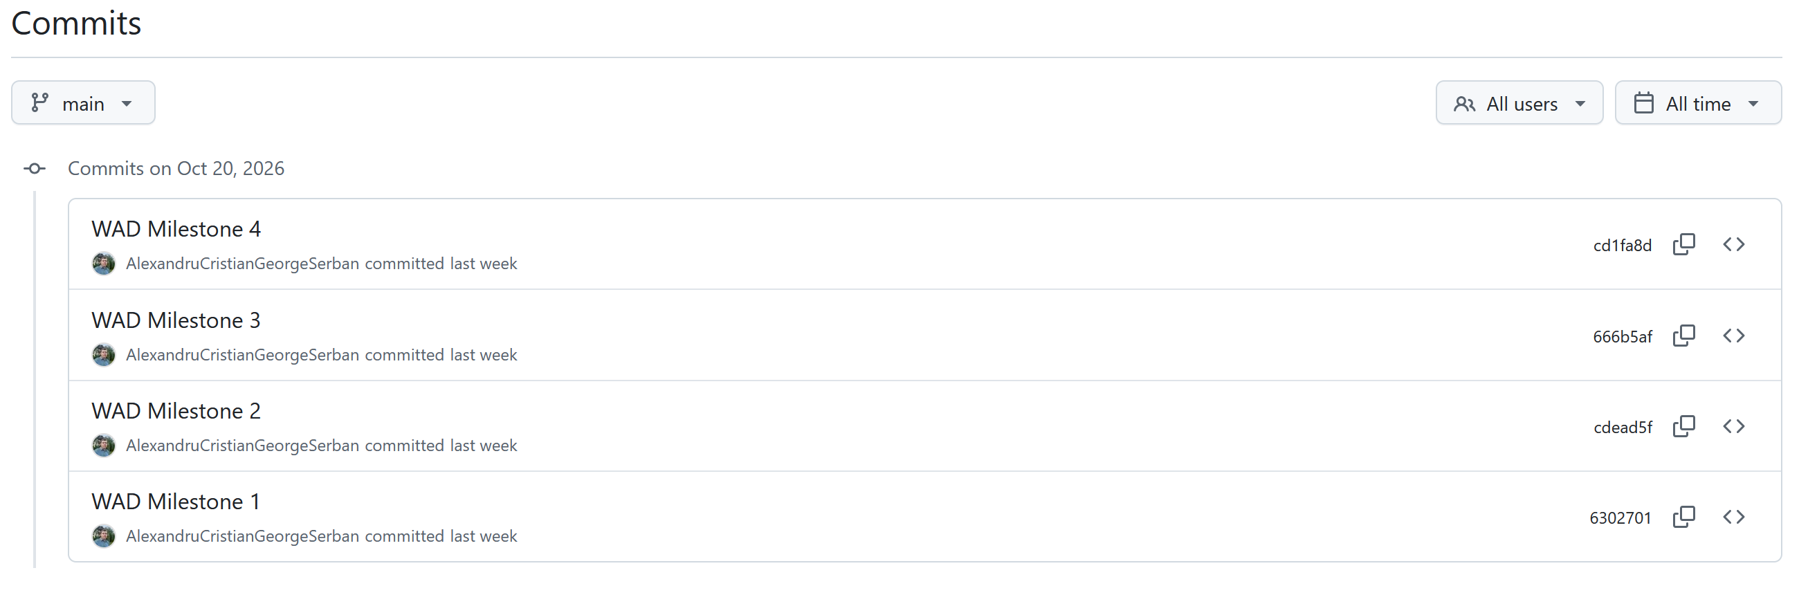
12 / PLANNING & GOVERNANCE
11-week roadmap with visible project traceability
Milestones align with the course plan: proposal → minimal prototype → complete implementation and demonstration.
WEEKS 1–3
WEEKS 4–7
WEEKS 8–11
Report 1
Report 2
Final Report
Project Proposal
Minimal Design & Prototype
Implementation & Demo
Specifications, selected tools, baseline architecture, and Use Case Diagram.
Prototype TF-IDF recommendations, ML.NET classification, and smart assignment.
SignalR chat, SLA worker, end-to-end testing, metrics, and complete demo.
CURRENT STAGE
PROTOTYPE
DELIVERY
TRACEABILITY WORKFLOW
GitHub Issue
Atomic commit
Milestone
Report / Demo
Track features, bug fixes, and milestones; use commits that correspond to one focused change.
PROJECT III / TOOLS FOR PROGRAM DEVELOPMENT
13
Notes:
The roadmap follows the 11-week course schedule. Weeks 1–3 prepare Report 1, weeks 4–7 produce a minimal design and prototype, and weeks 8–11 complete implementation, test measurements, documentation, and demonstration. Stress that each feature and bug fix should be traceable to GitHub Issues, milestones, and atomic commits.

Slide 14
13 / WRAP-UP
A practical path from ticketing to intelligent support
The proposal adds intelligence around an existing application while preserving its layered architecture and role model.
01
Reuse the baseline
02
Automate triage
Extend the existing ASP.NET Core MVC application rather than rebuilding its core ticketing workflow.
Use ML.NET and semantic similarity to help route tickets and surface already-known solutions.
03
Improve operations
04
Make progress verifiable
Balance assignments, monitor SLA deadlines, and notify users and agents in real time.
Track implementation with Issues, milestones, atomic commits, prototype evidence, and a final demo.
NEXT STEP
Finalize Report 1 artifacts, commit them to GitHub, and begin the Report 2 prototype.
PROJECT III / TOOLS FOR PROGRAM DEVELOPMENT
14
Notes:
Close by reminding the audience that the intelligent modules are planned work. The immediate deliverable is a traceable proposal, followed by a minimal prototype and then the complete implementation and live demonstration in the remaining weeks.

